Slide 1
Ridgeline Apparel Supply
Pashun Pro Tee — Capability & Pricing Deck | Prepared for Pashun Sports Ltd | January 2026

Slide 2
Agenda
Company overview and facility
Fabric capability and specifications
Manufacturing capacity and lead times
Quality assurance and testing
Pricing and minimum order quantities
Delivery and logistics
Commercial terms
Why Ridgeline

Slide 3
Company Overview
Ridgeline Apparel Supply — performance fabric manufacturer, Georgia, USA
In operation since 2011, specialising in performance-blend knit fabrics
Existing supplier of record for the Pashun Pro Tee US range
Single-site facility with in-house knitting, dyeing and finishing

Slide 4
Facility Overview
Georgia, USA facility — knitting, dyeing, finishing and QA under one roof
Annual capacity: approximately 4.2 million metres of finished fabric
ISO 9001 certified quality management system
On-site test lab for tensile, pilling and colourfastness testing

Slide 5
Fabric Capability
Performance-blend knit — polyester/cotton blend engineered for athletic wear
Moisture-wicking finish applied at the dyeing stage
Four-way stretch construction for garment comfort and fit retention
Current Pro Tee fabric supplied at $4.10/metre, 0.35m per unit

Slide 6
Material Composition
Component | Fibre | Share
Face yarn | Polyester (recycled) | 65%
Base yarn | Cotton | 30%
Stretch yarn | Elastane | 5%

Slide 7
Weight & Construction
Fabric weight: 180 gsm (grams per square metre)
Knit construction: single jersey, 28 gauge
Finished width: 165cm, usable width 160cm after edge trim

Slide 8
Colourways Available
Navy and Charcoal — current Pashun Pro Tee colourways, in stock dye lots
Additional colourways available to order: Forest Green, Slate Grey, Burgundy
Standard dye-lot tolerance: Delta E ≤ 1.0 against approved lab dip

Slide 9
Performance Test Standards
Tensile strength: ASTM D5034 (grab test)
Pilling resistance: ASTM D3512, rated 4+ after 3 hours
Colourfastness to washing: AATCC 61, rated 4+ minimum
Moisture wicking: AATCC 195

Slide 10
Wash-Cycle Durability
Fabric tested to 50 domestic wash cycles with no significant shrinkage
Shrinkage tolerance: ±3% length and width after 5 washes
Seam integrity verified after 30 wash cycles

Slide 11
Manufacturing Capacity
Current utilisation: approximately 70% of annual capacity
Available capacity for new orders: up to 1.8 million metres/year
Standard production lead time: 3 weeks from confirmed purchase order
Rush production available at a premium, subject to capacity

Slide 12
Standard Lead Times
Order size (units) | Lead time | Notes
Up to 2,500 | 3 weeks | Standard Pro Tee run size
2,501 – 6,000 | 4 weeks | Requires advance yarn booking
6,001 – 12,000 | 6 weeks | Subject to dye-lot scheduling
12,001+ | 8–10 weeks | Requires capacity reservation

Slide 13
Pricing Overview
Base performance-blend fabric: $4.10/metre at 2,000-unit order quantity
Volume pricing available at higher order quantities (see next slide)
Prices quoted in USD, FOB Georgia facility

Slide 14
Volume Pricing (per metre, USD)
MOQ (units) | Price/metre | Effective unit fabric cost*
2,000 | $4.10 | $1.44
6,000 | $3.95 | $1.38
12,000 | $3.80 | $1.33
22,000 | $3.65 | $1.28

Slide 15
Minimum Order Quantities
Standard MOQ: 2,000 units per colourway per order
New colourways (outside Navy/Charcoal): 3,000-unit MOQ for first run
Reorders against an approved dye lot: no minimum beyond standard MOQ

Slide 16
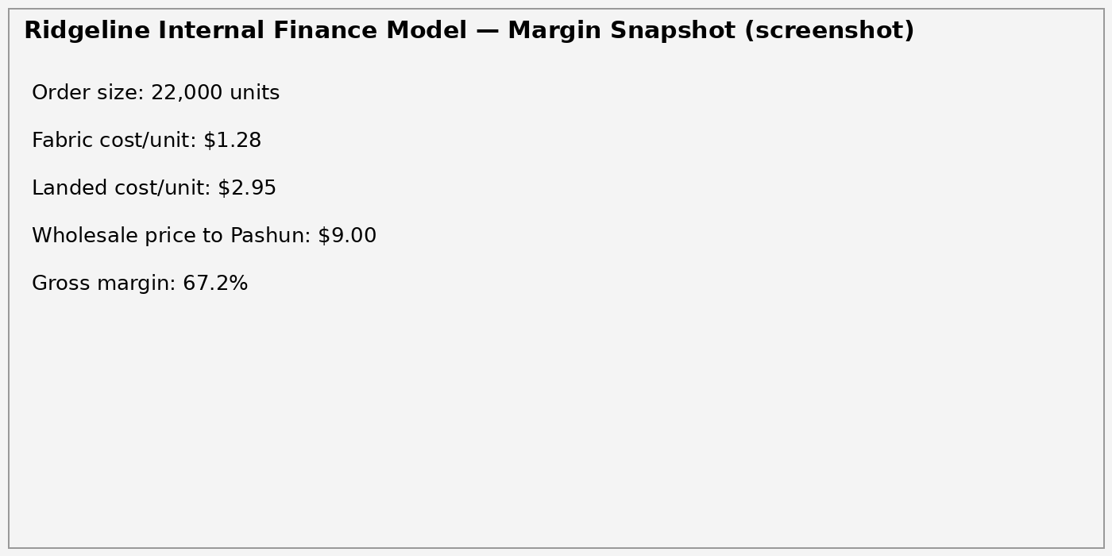
Indicative Margin Analysis (pasted from Finance model)
(Figures above are embedded as a picture, not as text or a native table)

Slide 17
Delivery & Logistics
Standard shipping: FOB Georgia facility, freight arranged by Pashun Sports (Harbor Freight Logistics)
Delivery to Pashun's US distribution point: 3–5 business days after dispatch
Consolidated shipping available for orders across multiple colourways

Slide 18
Indicative Delivery Dates (from PO confirmation)
Order size | Production | Transit | Total
2,500 units | 3 weeks | 4–5 days | ~3.7 weeks
6,000 units | 4 weeks | 4–5 days | ~4.7 weeks
22,000 units | 8–10 weeks | 5–7 days | ~9–11 weeks

Slide 19
Quality Assurance & Inspection
100% fabric roll inspection prior to cutting
AQL 2.5 sampling on finished garment inspection (if cut-and-sew is in scope)
Dedicated QA contact assigned per account

Slide 20
Commercial Terms
Payment terms: Net 30 from invoice date, standard for existing accounts
Pricing held for 90 days from quote date
Currency: USD throughout — no currency exposure for US-based buyers

Slide 21
Why Ridgeline Apparel Supply
Existing, proven relationship with Pashun Sports on the Pro Tee range
US-based manufacturing — no import duty or currency exposure
Consistent 3-week lead time on standard orders
In-house testing removes reliance on third-party labs

Slide 22
Contact
Dana Whitfield | Ridgeline Apparel Supply | Georgia, USA | Account contact for Pashun Sports Ltd

